Slide 1
Variations in Community-Engaged Scholarship
Diane M. Doberneck, Ph.D., connordm@msu.edu
Director for Faculty and Professional Development
Office for Public Engagement and Scholarship
Adjunct Associate Professor Department of Community Sustainability
Michigan State University
Emerging Engagement Scholars Workshop, Athens, GA
Master Class #2, September 2022
Notes:
Seminar handouts
Key Concepts Handout
Networks and Journals Handout
UOE Infographic on growth in engagement offices
Consider Your Communities
Brown & Lambert's Nested Knowledge Systems
Sem 1 Powerpoint

Slide 2
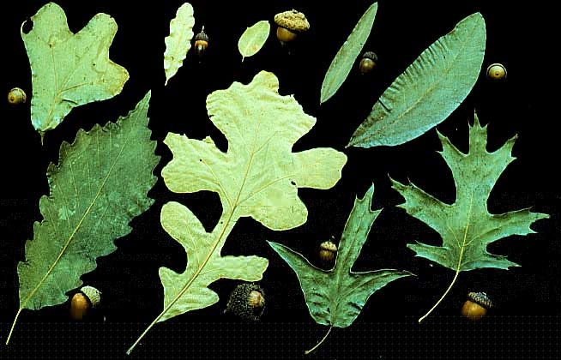
Importance of Understanding Variations in Community Engaged Scholarship

Slide 3

Why Focus on Variations?
Community-Engaged Scholarship is a broad term, an umbrella over many different types of activities.
It can be very confusing to understand exactly what other people mean when they use any terms associated with Community-Engaged Scholarship.
It’s important, when you talk about your own work, that you provide enough details so others can understand what you are talking about and situate or connect your community-engaged work to their experience and understanding.

Slide 4
Why Focus on Variations? Continued
Avoids the tyranny of “one size fits all” mentality and the associated underlying assumption that it has to be my size (not yours).
Helps clarify conversations between you and your community partners—what exactly are their needs and expectations? What are yours? How might you work together to meet them?
Provides guidance for how you talk about your own community-engaged scholarship in a way that others can understand you better.
Helps you identify others who think about, practice, and write about work similar to yours—locate your work in relation to the discourse about community-engaged scholarship.

Slide 5





Without Clarifying Your Variation

Slide 6





With Clarification

Slide 7
Main Variations in Community-Engaged Scholarship
Type(s) of Community Engaged Scholarship
Community
Your community partner(s)
Community partner knowledge
Structure of your community partnership
Duration
Intensity of activity
Societal issue you are addressing
Nested position within systems
Degree of engagement
Techniques for collaboration
Foundational Scholarship
Academic products
Public products
Motivations
Notes:
HANDOUT.
During the rest of this seminar/workshop, we are going to focus on Community Partner Knowledge (#4). Degree of Engagement (#10), Academic Products (#13), Public Products (#14), and Motivations (#15). Other seminars will focus the other variations.

Slide 8

Motivations—What is Your Why?

Slide 9

Opening Reflection
Reflect for a moment on why community engagement is important to you?
What is your WHY?

Slide 10
Institutional Motivations
Re-establish public’s trust in its institutions, when public trust in institutions is at an all time low; improve university-community relationships
Address pressing issues—health and health care, climate change/sea level rise, educational equity, military transitions
Be viewed as relevant, lifelong learning partner by the public
Make a difference in the communities where we are situated…or in our global community
Secure funding from donors, stakeholders, and funders for conducting relevant scholarship
Distinguish your institution from the other institutions of higher education
(Gaventa & Bivens, 2014; Overton et al, 2017; Saltmarsh & Hartley, 2011;
Stanton 2008; Van de Ven 2007; Watson et al, 2011)

Slide 11
Research Motivations
Address problems that are relevant to society, including public, private sectors
Refine research questions by having public, nonprofit, or industry input
Develop research applications that contribute to local and regional economic success
Enrich the research process and outcomes
improve quality and validity of research by engaging local knowledge and experience
enhance relevance and usefulness of data
Increase meaning and sense-making in interpretation
Develop more clearly defined implications for policy, practice, teaching/learning, and community impact
What else?
(Balazs & Morello-Frosch 2013; Ochocka & Janzen 2014; Strand et al, 2003)

Slide 12
Teaching and Learning Motivations
Involve students in high impact practices (pedagogy)—service learning; community-based, undergraduate research; study abroad with service-learning components
Engage in teaching/learning practices that help to develop
Disciplinary understanding, applications, and problem-solving
Cross-cultural, diversity, and inclusive mindsets and practices
Professionalism and career readiness
Leadership development
Other learning outcomes
Promote civic attitudes and behaviors (democratic principles)
Tap into community partner knowledge and wisdom
What else?
(Butin, 2010; Crabtree 2008; Jacoby, 2015; Kuh 2008)

Slide 13
Service and Practice Motivations
Develop policies that are informed by local knowledge, lived experience
Develop management strategies and policies that are more likely to be followed—improve compliance
Create a sense of ownership by those affected and involved, which may lead to changes that are sustained over time
Strengthen a sense of empowerment
Respond to community-identified issues
What else?
(Pasick et al 2010; Reed et al, 2009)

Slide 14
Personal Motivations
Commitment to a particular place or people
Related to personal or professional identity
Desire for collaboration, relationship-building, partners, or place-making
Reflection of values, including those related to
Preferred epistemology
Lived experience
Faith
(O'Meara, 2008; Post et al 2016)

Slide 15
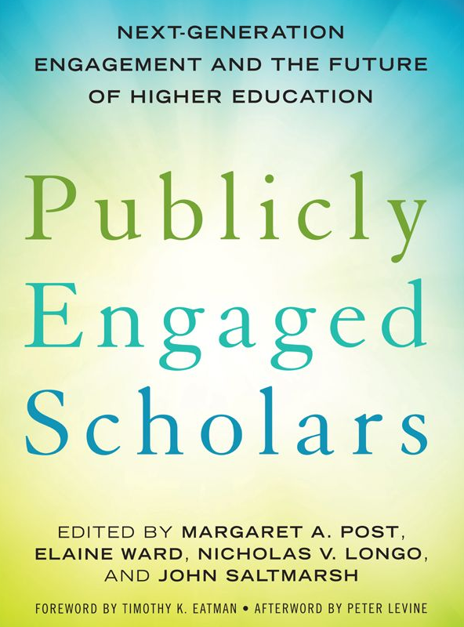
Future-Oriented Motivations
Recruitment and retention of talented faculty
Historically under-represented faculty
Female faculty
Faculty of color
Lower income
First generation
Faculty whose research & teaching is connected with their identity
Faculty who have participated in service-learning, community engagement as undergraduates and graduates

Slide 16

Pause to Reflect as the Whole Group:
In the chat, tell us your 1 or 2 whys…
Institutional reasons?
Research reasons?
Teaching and learning reasons?
Service and practice reasons?
Personal reasons?

Slide 17
Transitions In The Movement’s Vocabulary in Higher Education
Service
Outreach
Engagement
Prior to
1990s
2010s
to today
Time
Notes:
Because the vocabulary has changed over a relatively short span of history, there is significant overlap and confusion about how the terms are used across the academy.
Some disciplines say outreach, but mean engagement. Some say engagement, because it’s a popular expression now, but really mean outreach. Still others say service.
We’ll now discuss each of these terms…

Slide 18
Service refers to…
Work completed for department, college or university (e.g., admissions committee)
Work done for a professional or disciplinary organization (e.g., conference committee)
May or may not include application of disciplinary knowledge
May or may not have scholarly foundations
May or may not generate academic of public products
Often considered “what a good citizen” does.
Volunteerism
(Neumann & Terosky, 2007)
Notes:
Service is still commonly used in many institutional policy documents. Confusing.

Slide 19
Internal Collaboration refers to….
Work done with other departments, colleges, or universities
Bi-directional flow of knowledge between divisions or agencies, but does not involve knowledge from external stakeholders or community partners
Distinction between knowledge producers and knowledge consumers (e.g., the academy produces knowledge & public consumes it)
Primacy of scientific knowledge
The academy is the center of public problem-solving

Slide 20
Outreach refers to…
Academic work done for the public
Dissemination of Applied knowledge
Unidirectional flow of knowledge (e.g., from the university to the public)
Distinction between knowledge producers and knowledge consumers (e.g., universities produce knowledge & public consumes it)
Primacy of academic knowledge
University as center of public problem solving (adapted from Saltmarsh & Hartley, 2011, p. 22)
Notes:
There are disciplinary clusters that were early adopters of the word outreach, like areas of the natural sciences that came to widely promote science outreach programs.

Slide 21
Engagement refers to…
Academic work done with the public.
Inclusive, collaborative, problem-orientated
Multi-directional flow of knowledge
Co-creation of knowledge (e.g., both universities and communities together create solutions)
Shared authority for knowledge creation (e.g., both universities and communities have relevant knowledge)
University as part of an ecosystem of knowledge production addressing public problem solving
Community change that results from the co-creation of knowledge (adapted from Saltmarsh & Hartley, 2011, p. 22)
Notes:
Engagement has become a popular expression among those who work on, advocate for, or study community-engaged scholarship.
Perhaps a victim of its own success, however, engagement has become popular among others within higher education. Folks who work in student development, for example, use it to discern between students who are increasingly active and invested with others in academic, co-curricular, and social activities, as opposed to disengaged students, who are less involved and/or self-isolating.

Slide 22
Continuum of Community-Engaged Knowledge Making
Continuum of scholarship with traditional approaches to research, teaching, and service on one end….and highly collaborate, co-creative approaches on the other end…and a range of gradations along the continuum where scholarship may be located (Ellison & Eatman, 2008, pg. 5-6)
Internal Collaboration
Service
Outreach
Engagement
No Stakeholders & Community Partners
Stakeholders &
Community Partners
Notes:
NOTES: Continuum connotes different degrees of collaboration, decision-making authority, reciprocity, and mutual benefit.

Slide 23
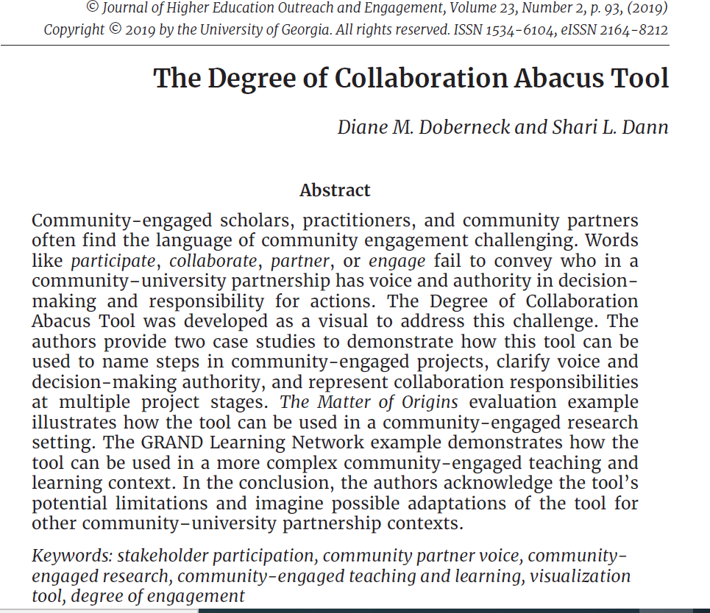

Resource: Doberneck & Dann (2019) Degree of Collaboration Abacus

Slide 24
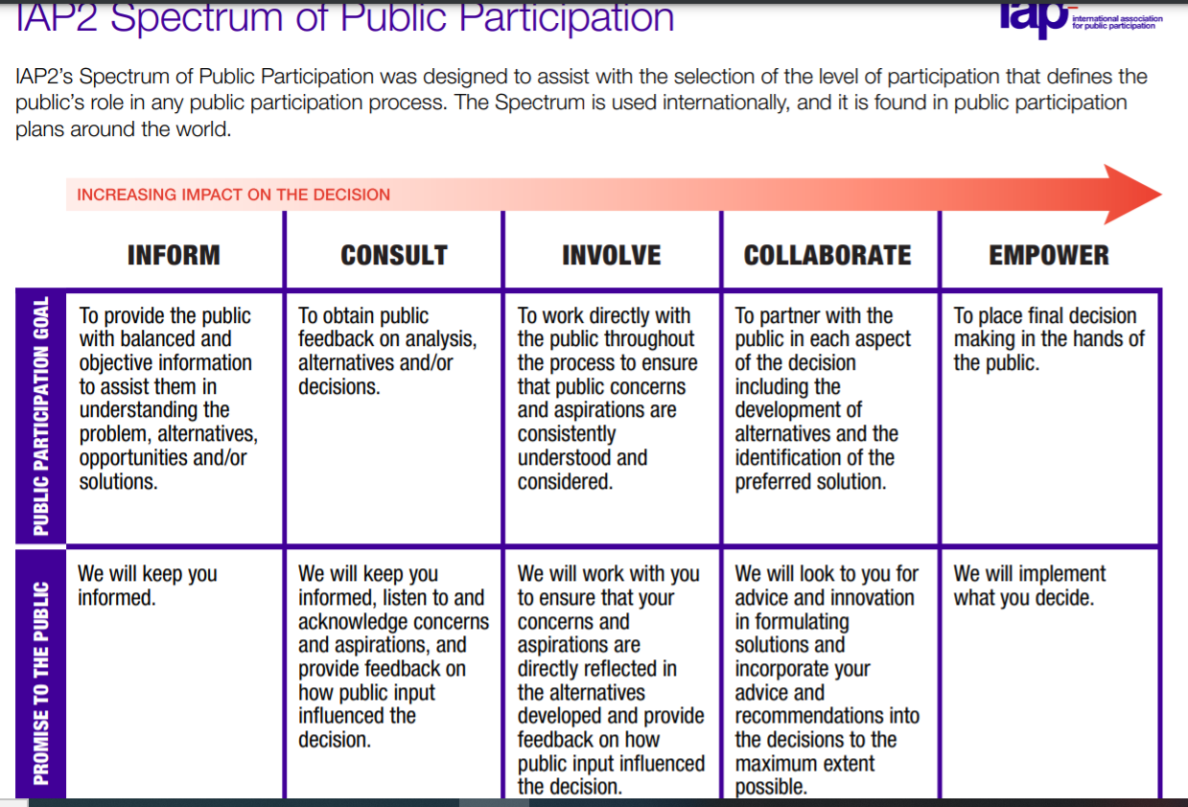
Resource: IAP2 Spectrum of Participation https://cdn.ymaws.com/www.iap2.org/resource/resmgr/pillars/Spectrum_8.5x11_Print.pdf

Slide 25
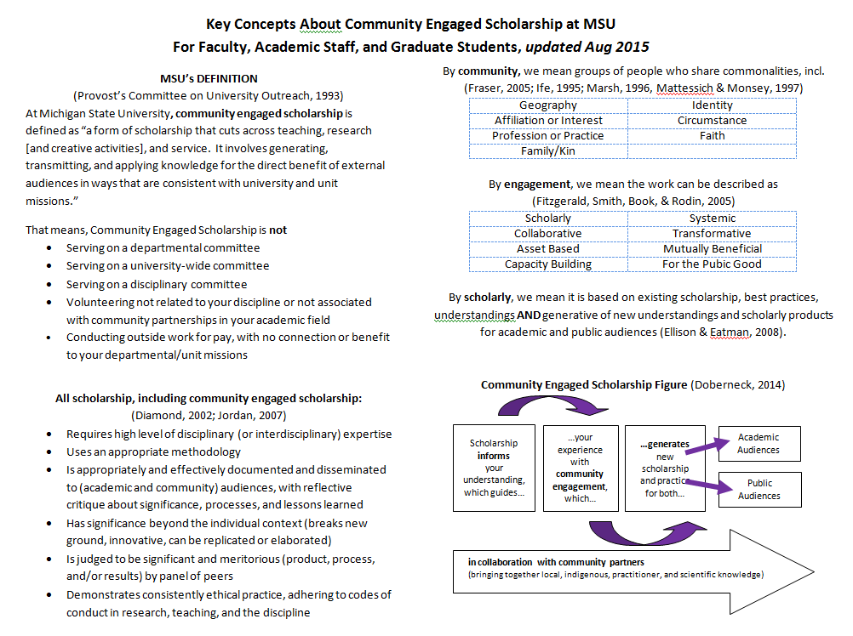
Key Concepts in Community- Engaged Scholarship (See Handout)
Notes:
Refer to the “Key Concepts” handout.

Slide 26
Community-Engaged Scholarship Figure (Doberneck et al, 2017)
…your experiences with community engagement, which, then in turn…
academic audiences
Scholarship informs your understanding and guides…
…generate new scholarship and practice for both…
public audiences.
In Collaboration with Community Partners (including local, indigenous, or practitioner knowledge)

Slide 27
What Do We Mean by Scholarly?
Scholarship (Diamond, 2002)
Requires a high level of discipline (or interdisciplinary) expertise
Conducted in a scholarly manner
Clear goals
Adequate preparation
Appropriate methodology
Is appropriately and effectively documented and disseminated to (academic and community) audiences, with reflective critique about significance, processes, and lessons learned
Notes:
NOTE:
These are the same criteria used by academic units to assess the quality non-engaged scholarship as well.

Slide 28
What Do We Mean by Scholarly, Continued
Has significance beyond the individual context.
Breaks new ground or is innovative.
Can be replicated and elaborated.
Is judged to be significant and meritorious (product, process, and/or results) by panel of peers.
Added by Jordan (2007)
Includes reflective critique: Lessons learned to improve scholarship and community engagement.
Specifies role, leadership, and personal contribution.
Demonstrates consistently ethical practice, adhering to codes of conduct in research, teaching, and the discipline.

Slide 29
Criteria for Quality & Excellence
Standards of Scholarship (Glassick, Huber, & Maeroff, 1997) | Criteria for Evaluating Community-Engaged Scholarship (Jordan, 2007; Seifer, 2007)
Clear goals | Clear goals and community goals
Adequate preparation | Adequate preparation in content area and ground in public scholarship
Appropriate methods: rigor | Appropriate methods rigor and community engagement
Significant results: impact on the field | Significant results impact on the field and in the community
Effective presentation | Effective presentation/dissemination to academic and community audiences
Reflective critique | Reflective critique; lessons learned to improve scholarship and community engagement
 | Leadership and scholarly contribution
 | Consistently ethical behavior, social responsible conduct

Slide 30
Foundational Scholarship is… (See Handout)
…the body of knowledge that informs and guides your community engagement. It could be:
About the issue
Disciplinary Theories, Conceptual Frameworks, or Models
Scholarship of Engagement (SoE)
Scholarship of Teaching and Learning (SoTL)
Population, Community, Context, or Setting
Paradigms, Methodologies, or Approaches
Collaboration Techniques, Engagement Processes, or Methods
Reflection, Evaluation, Assessment, or Lessons Learned
Or any combination
Notes:
Refer to the “Foundational Scholarship Worksheet” handout.

Slide 31
Ex. 1: Trouble with the Trees (Carmichael & McDonough, 2018)
A community-engaged forestry researcher seeks to understand why residents in certain neighborhoods do not want free street trees planted in front of their houses. Why is there resistance to an idea that makes good environmental sense?
Foundational scholarship includes:
Environmental benefits of urban tree canopy and community forestry (social issue being addressed)
Political ecology, critical race theory (disciplinary and interdisciplinary theories)
Community engaged research (paradigm, methodology, approach)
Heritage narratives (collaboration technique, method, engagement process)
Notes:
This is a CE Research Example

Slide 32
Ex. 2: Family Story Project Ronald McDonald House, Durham, NC (Denice Kendall Comer, https://discovery.indstate.edu/jcehe/index.php/joce/article/view/474/)
A faculty member involves pre-health students in a service-learning course, where family members, sick children, and university students partner together to help children write about and portray their experiences coping with serious illnesses. Booklets of stories and photos are co-developed each year with the families.
Foundational scholarship includes
Narratives about health (paradigm, methodology)
Ethics, especially working with sick children (population, community, context)
Photovoice (techniques, methods or approaches)
Notes:
This is a CE Teaching & Learning—Service Learning example

Slide 33
Ex. 3: Weekend Backpack Program
A community-engaged social work graduate student is studying the early stage impacts of a weekend backpack food program on reducing hunger for middle school children living in a low income housing community.
Foundational scholarship includes:
research about food insecurity and hunger (social issue of concern)
program implementation in low income housing communities (scholar’s discipline or field)
effective practices for engaging middle school children (population)
developmental evaluation (evaluation, assessment, reflection, assessment)
Notes:
This is a CE Service and Practice Example

Slide 34
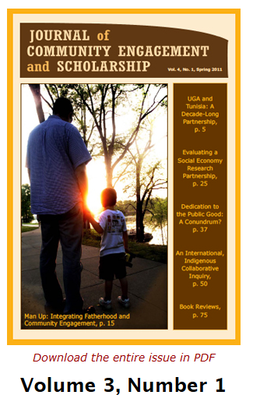
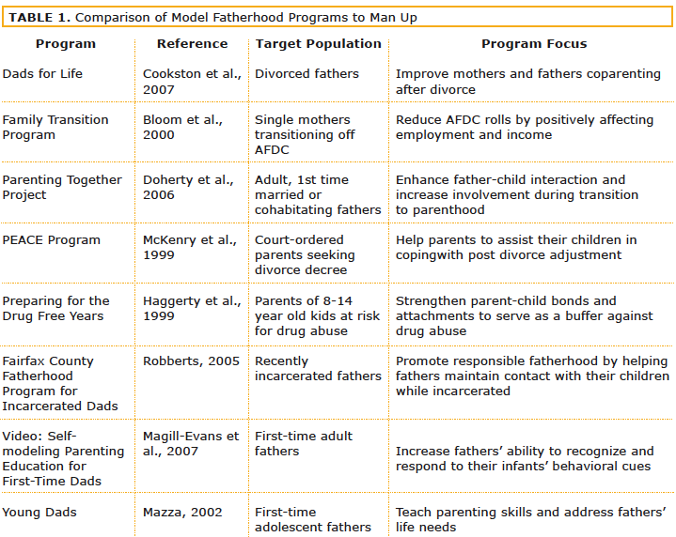
Man Up article in JCES: Example of Foundational Scholarship

Slide 35
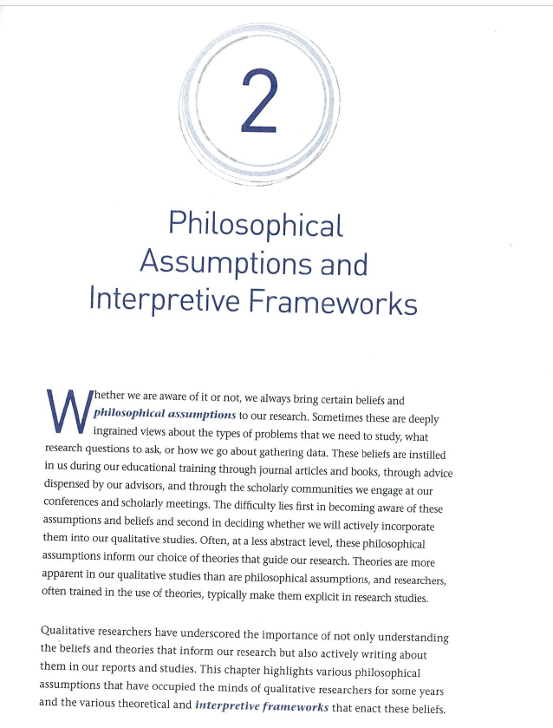
Resource: Creswell & Poth (2018)
Explains how research choices need to align throughout the research design process
Provides summaries of postmodern perspectives
Also discusses interpretive research traditions

Slide 36
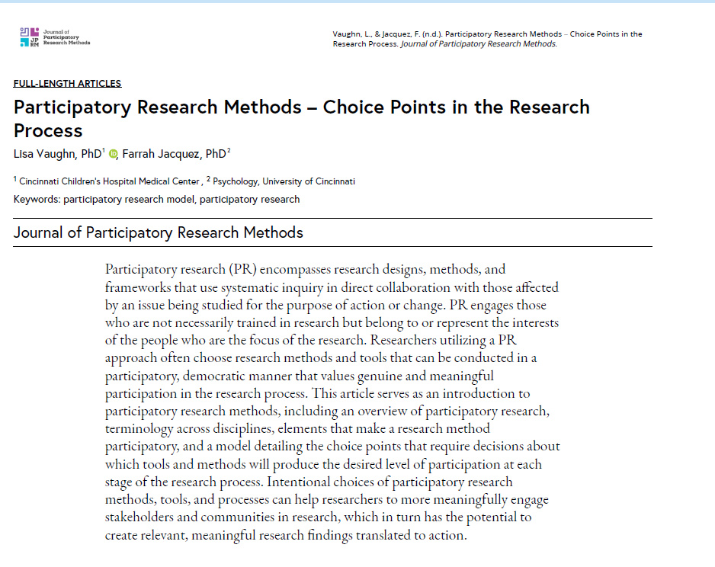
Resource: Vaugh & Jacquez (2020)
Fantastic 2-page table that lists out participatory research traditions, including some innovative ones.
Solid discussion of participation choice points among IAP2’s inform, consult, involve, collaborate, & empower

Slide 37
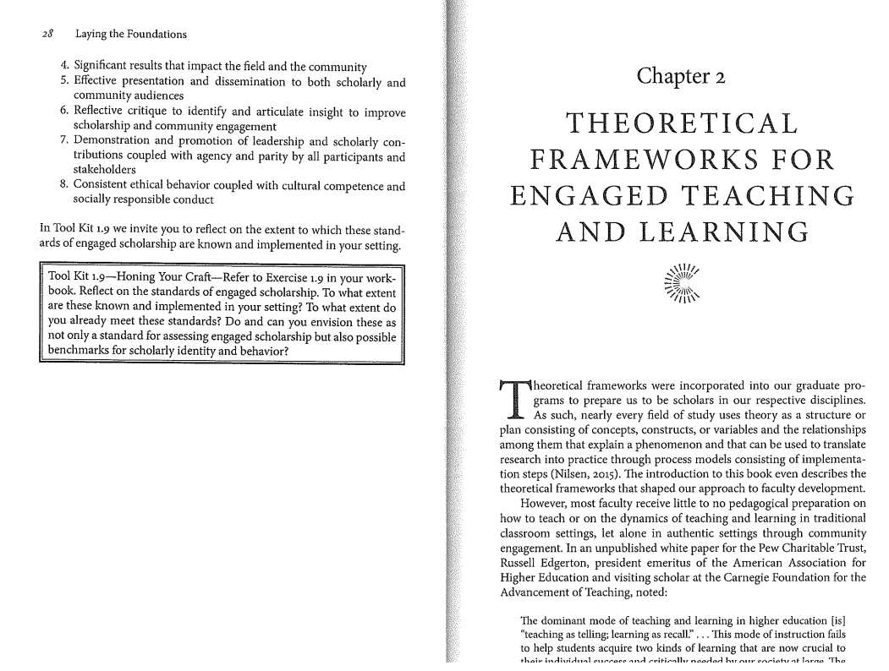
Resource: Theoretical frameworks for engaged teaching and learning (chpt. 2) Welch & Plaxton-Moore (2019)
Reviews type & foci for courses
Mentions critical-service learning, liberating service-learning, and decolonizing service-learning

Slide 38

Foundational Scholarship Worksheet (Doberneck et al, 2017)

Slide 39
Pause to share….tell us about your foundational scholarship?
What are the theories, conceptual frameworks, or best practices you are using to guide your community work?

Slide 40
“Engaged” Incorporates Community Knowledge
…your experiences with community engagement, which, then in turn…
academic audiences
Scholarship informs your understanding and guides…
…generate new scholarship and practice for both…
public audiences.
In Collaboration with Community Partners (including local, indigenous, or practitioner knowledge)

Slide 41

What Do We Mean By Community?

Slide 42
Communities Defined
Geography
Shared physical space such as a neighborhood or region
Identity
Shared race, gender or other characteristics
Affiliation or interest
Shared a common set of values or concerns
Profession or practice
Shared specific knowledge to occupation, skill, or trade
Circumstance
Shared common experience, such as surviving a disease or natural disaster
Faith
Shared belief systems, customs, religion, or spiritual practice
Kin
Shared relationships through family or marriage

Slide 43
Complex Identities & Intersectionality
Patients at health screening clinic at an urban refugee center
Geography, circumstance
Chemistry club students at a rural middle school
Interest, identity, circumstance
Hispanic fishers in inland lakes that have harmful algal blooms
Identity, interest, circumstance

Slide 44
Pause to share, tell us….
Who are the communities with whom you partner and co-create?
If there are intersections, tell us about them.

Slide 45
Explicit and Tacit Knowledge
Explicit Knowledge: can be transmitted in formal, systematic language. Definitions, equations, published theories, textbooks, etc.
Tacit Knowledge: mental models about how the world works. Know-how, experience, incidental learning, apprenticeship, stories, “knowing-in-action.” (Nonaka & Takeuchi, 1995; Schön, 1995).
Engaged scholars value, surface, and incorporate the tacit knowledge of community members and practitioners into their community-engaged work.

Slide 46
Local Knowledge
Local knowledge “depends on unaided senses, accumulates in a time-bound fashion through aggregative experience, and is holistic” (Kloppenburg, 1991, p. 537).
In simpler language, local knowledge is developed through the lived experiences or daily practices of people living in a specific place and time.
Local Knowledge
cannot be generalized to other places or times
Is often tacit
“how things are done around here” “that’s just how it works” “everyone knows that’s what happens”
can be held by members of dominant and non-dominant cultures
Notes:
May also be explicit or tacit

Slide 47
Indigenous Knowledge
Indigenous Knowledge is similar to local knowledge, because it is based on practices specific to a place society. However, unlike local knowledge, indigenous knowledge is the result of sustained interaction between indigenous peoples and their environment, passed down over generations. It has significant historical, cultural, and social dimensions (Argawal, 1995).
Indigenous knowledge
represents a holistic, inclusive way of knowing
embodied in indigenous and Native cultures
distinct and separate from dominant cultures
Notes:
May also be explicit or tacit.

Slide 48
Practitioner Knowledge
Practitioner knowledge comes from a professional or worker’s knowledge gained through the interactions that occur over time, in the context of the work. It is not a way of knowing based on objective analysis, but more from an intuitive, multi-sensory feel for the work based on experience and reflection (Schmidt, 1993).
Practitioner Knowledge
Gained through the experience of every day life, especially work life
Knowledge or know-how individuals call upon to do their work
Often tacit, known by doing

Slide 49
Knowledge Cultures as Nested Systems
Each set of “decision-makers has their own goals, accepts certain types of evidence (and discounts other types), and its own language. In other words, we find we are dealing with different knowledge cultures, each with its own interests” (Brown & Lambert, 2013, pp. 40-41)
Key individuals
Affected communities
Specialist advisers
Influential organizations
Holistic thinkers
Holistic
Local
Individual
Specialized
Organizational
Notes:
Refer to “Knowledge Cultures” handout.

Slide 50
Scholarly Products For Multiple Audiences
…your experiences with community engagement, which, then in turn…
academic audiences
Scholarship informs your understanding and guides…
…generate new scholarship and practice for both…
public audiences.
In Collaboration with Community Partners (including local, indigenous, or practitioner knowledge)
Notes:
Remind them at that in Seminar One, we learned about
foundational scholarship
Types of community engaged scholarship
Community, community partners
NEEDS Accessibility

Slide 51

Why Talk About Academic and Public Products?
Talking about what might be useful—at the beginning of your collaboration—helps both parties be more thoughtful about what kinds of products they would both like at the end. This helps both parties be more strategic and creative along the way.
Discussing the different academic and public products also helps you to understand one another’s context better—making you a more respectful, understanding partner.

Slide 52

IA’s Figure 8: Academic & Public Products
Scholarship that is generated from community engagement has different audiences (academic and public/practitioner/community).
Those audiences have different information needs, communication styles, and general interests.
Engaged scholars, who are strategic with their work, purposefully create academic and public products so that their scholarship is accessible to multiple audiences.
(Ellison & Eatman, 2008, pg. x)
Public
Academic
Notes:
Image from: https://www.google.com/search?q=infinity&source=lnms&tbm=isch&sa=X&ved=0ahUKEwjquYyD5LPdAhVk_4MKHRHJDsMQ_AUICigB&biw=1920&bih=925#imgrc=1Pc55Sa0wPEKVM:

Slide 53
Examples of Academic Products
Academic Products
Dissertation
Thesis
Journal article
Book
Book chapter
Conference poster
Conference presentation
Grant proposal
Curriculum
Artistic performances
Peer Review
Journal editor
Blind reviewers for academic journals
Book editor
Editor of volume of book chapters
Conference organizers
Conference proposal reviewers
Grant reviewers—competitively funded grants
Juried shows
Competitive awards committees

Slide 54
Examples of Public Products
Public Products
Community presentations
Powerpoints
Infographics
Newsletter articles
Media—newspaper, TV interview, radio interview
Community workshops
Exhibitions, archives
Performances, festivals
K-12 or professional development curricula
POD casts, blogs, youtube channels, webpages
Peer Review
Grants reviewers—competitively funded grants
Practitioner associations’ awards and recognitions
Community awards and recognitions
Practitioner and Public Audiences want information and communication formats different from academic audiences.
All of these should appear on your resume or c.v.—under different headings than your academic work.

Slide 55
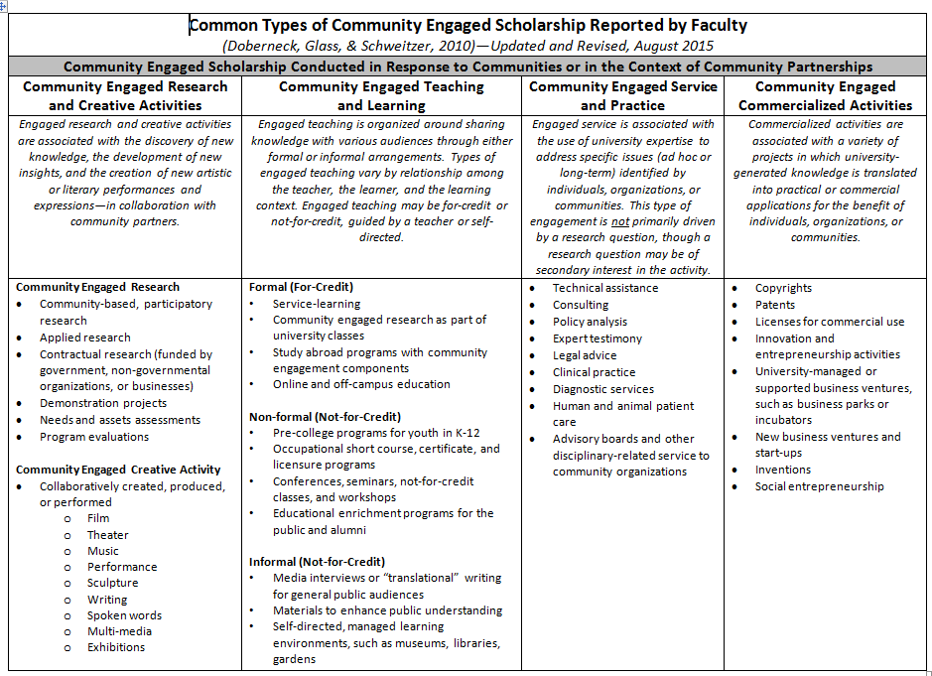
TYPES OF COMMUNITY- ENGAGED SCHOLARSHIP (Key Concepts Handout--back)
Notes:
Ask them to follow along on the back of the “Key Concepts” handout.
Ask them to “locate their work” on the back page

Slide 56
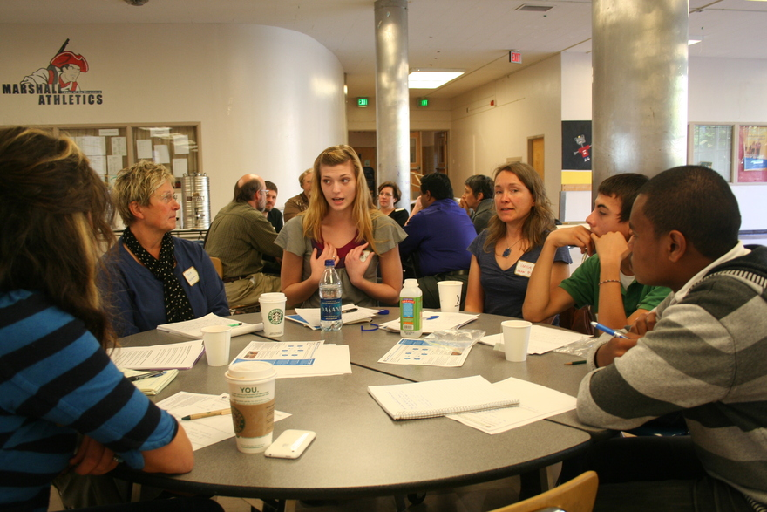
Community-Engaged Research Examples
Community-based, participatory research
Applied research
Contractual research (funded by government, non-governmental organizations, or businesses)
Demonstration projects
Needs and assets assessments
Program evaluations
Notes:
GradCert Examples:
Community psychology grad student works with employees and board members of women’s shelter to conduct an evaluation about empowerment, including clients’ views of shelter staff’s practices.
Archaeology grad student—following guidance of local history group—uses remote sensing equipment to determine presence of underground artifacts and structures.

Slide 57
Community-Engaged Research
Research or evaluation questions are primary driving force or focus of the activity with your community partner.
Follows steps similar to those in traditional research, however community partner voice is incorporated into the key decisions throughout the process (see handouts).
IRB approval is required for all university research that involves human subjects—including community engaged research. (See optional readings and http://hrpp.msu.edu/irb-review-needed).
Community engaged research is on a continuum--barely engaged---to 100% co-created and co-generated at every step.
Notes:
If you are working with students (in a class or as a supervisor of a community engaged research project), you need to be aware of your responsibilities for preparing them as community engaged researchers and with the IRB.

Slide 58
Community-Engaged Research is NOT…
Research conducted in a community setting, i.e., research IN a community
Research where data is gathered from subjects, without any input from them, i.e., research ABOUT or ON a community
Research conducted on behalf of a group of people, to benefit that group of people, i.e., research FOR a group of people
Research about service-learning, community engagement, i.e., scholarship of engagement or scholarship of teaching & learning
Community-Engaged Research is conducted WITH community partners having a say in making key decisions about the research process

Slide 59

The Stretch for CE Research
Maintaining rigor required for research (or re-defining it appropriately)….and at the same time….
incorporating community partner voice in the decision-making process
Notes:
Image is from: : https://www.istockphoto.com/illustrations/tug-of-war-kids?mediatype=illustration&phrase=tug%20of%20war%20kids&sort=mostpopular

Slide 60
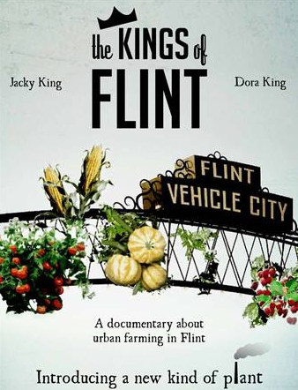
Community-Engaged Creative Activities Examples
Collaboratively created, produced, or performed
Theater
Music
Performance
Sculpture
Novels, plays, poetry
Spoken words
Film, documentaries
Multi-media
Exhibitions
Notes:
GradCert Examples:
REACH Studio Art Center works with youth group member, who identify bullying as an issue and select comic book illustration as a medium. Grad Cert student invites renowned comic book illustrator for youth workshops. Youth develop their own storyboards and comic book illustrations, which result in a off campus gallery show and reception.
Studio Art student proposes to work in Detroit based after school program for youth. Together they identify key ideas and experiences and work together to learn how to use metal and stone to create objects of art that represent their experiences.

Slide 61
Community-Engaged Creative Activities Are Not…
Creating a work of art that the artist makes so that it may reside in a community setting, like a park
Developing a work of art that addresses a community issues or topic, but is developed solely by the artist
Adding something creative to a traditional piece of scholarship (“just add glitter”)

Slide 62
The Stretch for CE Creative Activities
Being a master at your craft and artistry…and at the same time…
incorporating ideas and skill levels of your collaborating community partners.
Notes:
Image is from: : https://www.istockphoto.com/illustrations/tug-of-war-kids?mediatype=illustration&phrase=tug%20of%20war%20kids&sort=mostpopular

Slide 63
Community-Engaged Teaching and Learning
Definition
Engaged teaching (and learning) is organized around sharing (existing) knowledge with various audiences through either formal or informal arrangements.
Types of engaged teaching (and learning) vary by relationship among the teacher, the learner, and the learning context. Engaged teaching may be for-credit or not-for-credit, guided by a teacher or self-directed (Doberneck, Glass, & Schweitzer, 2010).
Notes:
Emphasize:
difference in for-credit, not for credit (informal, nonformal)
that this is important even for people interested in research (researchers are asked for interviews, to make materials, translate, etc., and are sometimes employed at liberal arts and comprehensive colleges where they are expected to teach)
including service-learning or community-based research into classes can be a way to incorporate community engagement into work assignments

Slide 64

Community-Engaged Teaching & Learning For-Credit Examples
For-Credit
Service-learning
Community-engaged research as part of university classes
Some study abroad programs with community engagement components
Online and off-campus education
Notes:
GradCert Examples:
Writing, Rhetoric, and American Cultures grad student supports service-learning students in an undergraduate writing class to partner with community nonprofits to write webpages, brochures, and other promotional materials that represent the priorities and voices of the nonprofit agencies.
African and African American studies grad student works with youth leadership group in Lansing K-12 school. The youth set the agenda for activities, which include their participation in service to their local communities.

Slide 65
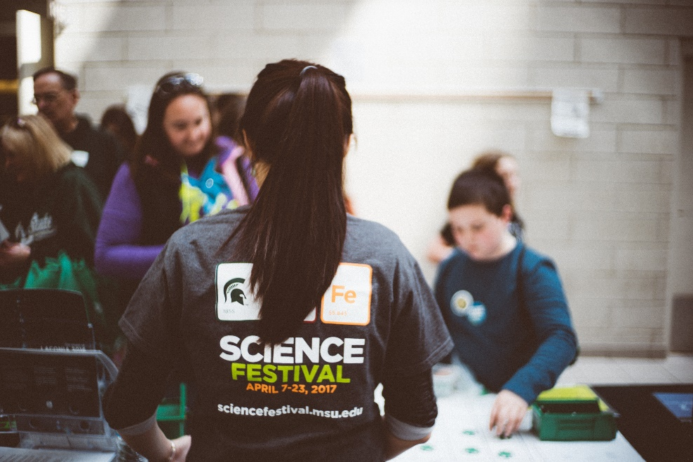
Community-Engaged Teaching & Learning Non-Formal Learning (Not-For-Credit) Examples
Pre-college programs for youth in K-12
Occupational short course, certificate, and licensure programs
Conferences, seminars, not-for-credit classes, and workshops
Educational enrichment programs for the public and alumni
Notes:
GradCert Examples:
Community Sustainability student and outreach coordinator for state-wide conservation organization provides educational workshops and trainings at special events to educate youth and their parents.
Education grad student coordinates LATTICE, a professional development network for school teachers and international students, and provides training in how to internationalize the curriculum.

Slide 66
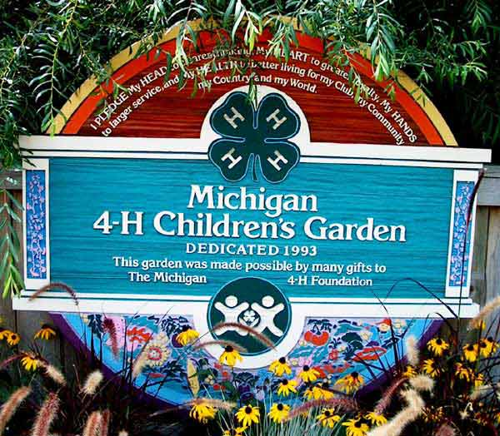
Community-Engaged Teaching & Learning Informal Learning (Not-For-Credit) Examples
Media interviews or “translational” writing for general public audiences
Materials made available to enhance public understanding
Science communications
Self-directed, managed learning environments, such as museums, libraries, gardens

Slide 67
What CE Teaching and Learning is NOT
Have your students learn in a community setting, where people associated with the community setting have little to no voice in shaping the learning experience
Some study abroad programs, internships, and other forms of experiential learning (these are valuable just not Service-Learning)
Have students contribute to improving the campus, without the involvement of non-campus people

Slide 68
The Stretch for CE Teaching & Learning
Being excited about your disciplinary topic and wanting to share your passion for it with other people…and at the same time…
making sure you tap into the Scholarship of Teaching and Learning, so you are using best practices for the type of CE Teaching and Learning (formal, nonformal, informal), and for the population you hope to teach.
Notes:
Image from: https://www.istockphoto.com/illustrations/tug-of-war-kids?mediatype=illustration&phrase=tug%20of%20war%20kids&sort=mostpopular

Slide 69
Community-Engaged Service and Practice
Definition
Engaged service is associated with the use of university expertise to address specific issues (ad hoc or long-term) identified by individuals, organizations, or communities.
This type of engagement is not primarily driven by a research question, though a research question may be of secondary interest in the activity (Doberneck, Glass, & Schweitzer, 2010).

Slide 70
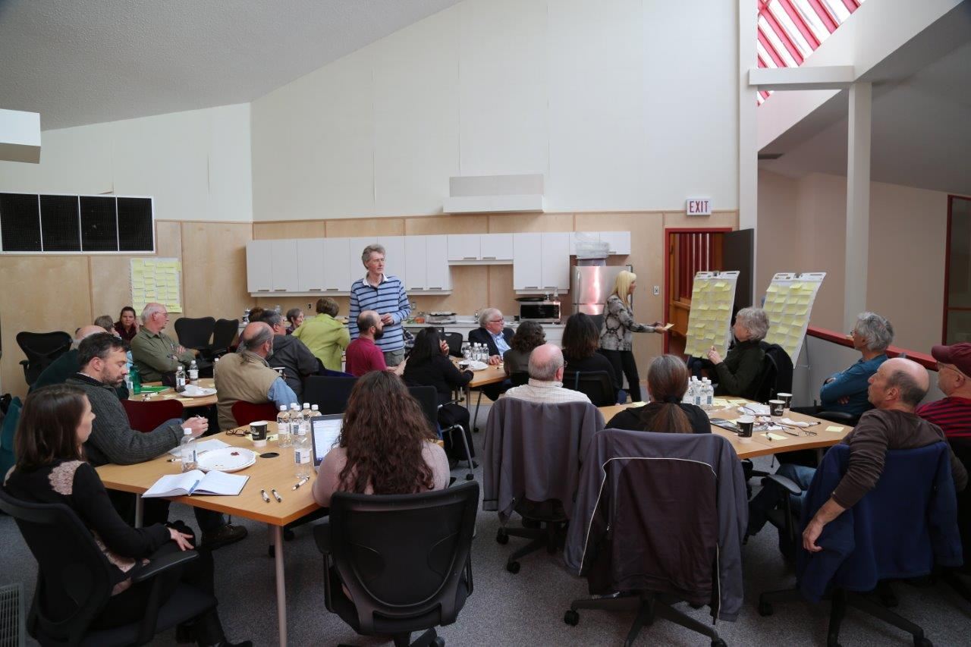
Community-Engaged Service and Practice Examples
Technical assistance
Consulting
Policy analysis
Expert testimony
Legal advice
Diagnostic and clinical services
Human and animal patient care
Advisory boards and other disciplinary-related service to community organizations
Notes:
GradCert Examples:
Community sustainability grad student works with youth leadership group at local nature center to design a “nature play” area for children to explore nature with little to no adult supervision.
Student affairs administration grad student uses her diversity/ inclusion and qualitative research skills to interview members of a local yoga studio and to develop story-based promotional materials for the studio to use on their website and in their marketing materials.

Slide 71
The Stretch for CE Service & Practice
Responding to the request for assistance from the public or a community partner…and at the same time…
ensuring you do your due diligence in identifying foundational scholarship—theories, conceptual frameworks, best practices—so that, in your haste to help, you do not implement something not proven to actually work, or just make stuff up.
Notes:
Image from: https://www.istockphoto.com/illustrations/tug-of-war-kids?mediatype=illustration&phrase=tug%20of%20war%20kids&sort=mostpopular

Slide 72
Community-Engaged Commercialized Activities
Definition
Commercialized activities are associated with a variety of projects in which university-generated knowledge is translated into practical or commercial applications for the benefit of individuals, organizations, or communities (Doberneck, Glass, & Schweitzer, 2011).
Notes:
Emphasize:
that this is a newer area
some disciplines more or less likely to engage in this
it may resonate with more people if it had a different name, perhaps “social entrepreneurship”

Slide 73

Community-Engaged Commercialized Activities Examples
Copyrights
Patents
Licenses for commercial use
Innovation and entrepreneurship activities
University-managed or supported business ventures, such as business parks or incubators
New business ventures
Technology Transfer
Inventions
Economic development
Social entrepreneurship
Notes:
GradCert Examples:
A Chemistry Ph.D student and Humphrey Fellow with an MBA collaborated with chemistry professors to identify and develop plans to commercialize results of their chemistry research.
A nonprofit leader collaborates with engineering faculty member to have capstone course undergraduates design and prototype three inventions that will simplify and make safer routine procedures at the nonprofit organization.

Slide 74
Relationships Among the CES Types
CE Research and Creative Activity
CE Service and Practice
CE Teaching and Learning
Integration
Notes:
NOTE: While “Key Concepts” handout shows four discrete columns representing types of community-engaged scholarship, and most people’s community-engaged scholarship falls in ONE column, there are definitely overlaps. For some, the columns may feel artificial because your work is in an overlapping area.

Slide 75
Pause to share….tell us
What type or types of community-engaged scholarship are you involved in?
Are you working at an intersection of more than one type? If so, tell us about it.

Slide 76
Who Participates? Whose Knowledge Counts?
Who is at the table?
Who is not at the table?
Why?
What can be done about that?
In Collaboration with Community Partners (including local, indigenous, or practitioner knowledge)

Slide 77
Acknowledging and Counteracting Inherent Biases About Participation (Chambers, 1983, 2006)
Spatial and project: where is being visited and what seen, and where is not being visited and not seen?
Person: who is being met, seen and heard, and who not met, seen, and heard—women, children, the sick, the very old, migrants, those who are busy, non-users of services, the marginalized and excluded?
Seasonal: what are things like at other times of the year?

Slide 78
Inherent Biases, Continued (Chambers, 1983, 2006)
Diplomatic: what questions are not being asked, where are you not going, whom are you not meeting because of politeness or timidity? Are you striking a good balance between being culturally and gender sensitive?
Professional: what are you predisposed to notice and ask about, and not notice or ask about?
Security: are insecure areas, and people who are insecure, being excluded?

Slide 79
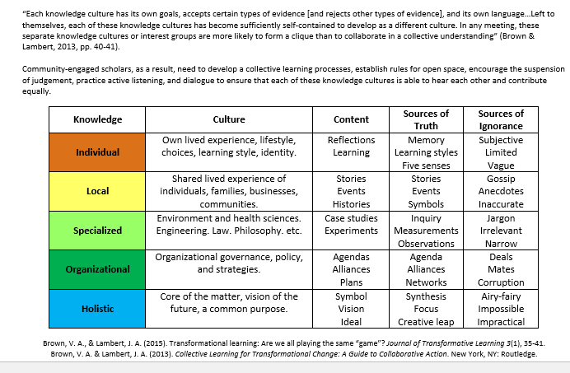
Brown & Lambert (2013) Knowledge Cultures

Slide 80
Knowledge Cultures & Participation (See Brown & Lambert (2013) handout)
 | Whom To Invite?
Key Individuals
Affected Communities
Specialist Advisors
Influential Organizations
Holistic Thinkers

Slide 81
Rainbow Diagram (See Chevalier & Buckles, 2008, pg. 167, handout)
Affected and Affecting
Least
Moderately
Affected
Affecting
Most

Slide 82
More about the Rainbow Diagram
Affected
Those who experience consequences
Most, moderately, least affected
Affecting
Those in positions to influence or address the issue
Constituents
Providers, front-line practitioners
Supporters
Management
Leadership
Funders
Decision-makers, policy-makers

Slide 83
Easy to Hard To Include Continuum (see Sarkissian et al, 2008 handout)
Exceptionally Easy to Include | Easiest to Include | Harder to Include | Even Harder to Include | Harder Still to Include | Hardest of All & Beyond Our Imagination
Proactive people who probably tend to dominate most processes unless actively countered Some activists Professional engagement specialists People with a direct stake in a directly relevant issue | Hard-to-reach people Children Older people Women Low-income people Geographically isolated people | Unaffiliated people “Apathetic” people Angry, betrayed, and disaffected people Impolite people acting inappropriately “Losers” from previous engagement processes | Homeless people Young people People from culturally and linguistically diverse communities People with disabilities | Faraway people, places, and societies you can’t imagine Dramatic-ally different cultures | The nonhuman realm Plants Animals Landscapes Bioregions Mountains All life every-where

Slide 84
Easy to Hard Continuum Worksheet (see Sarkissian et al., 2008)
Exceptionally Easy to Include | Easiest to Include | Harder to Include | Even Harder to Include | Harder Still to Include | Hardest of All & Beyond Our Imagination
Who Else From Your Community Engagement Context?
What Are Strategies to Include These Groups in Your Community Engagement?

Slide 85
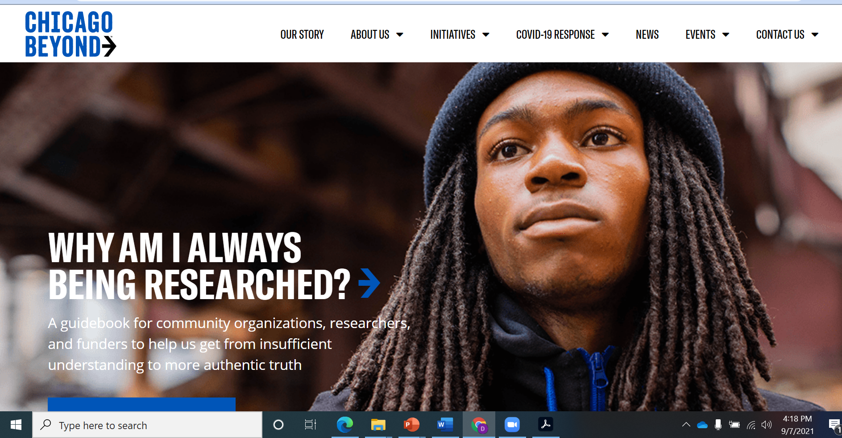
Resource: Why Am I Always Being Researched? https://chicagobeyond.org/researchequity/

Slide 86
Summary: What is Your Variation of CES?
What is your why?
What is your foundational scholarship?
Who are your communities? And community partners?
How is your community partner knowledge influencing your project and process?
What type of community-engaged scholarship are you doing?
What scholarly academic products do you anticipate developing?
What scholarly public products do you anticipate developing?
How are you identifying those not included and using strategies to include them?

Slide 87
Pause to share…please tell us
What are three take-away from today’s workshop?
What are your next action steps on these new ideas?

Slide 88
References
Agrawal, A. (1995). Dismantling the Divide Between Indigenous and Scientific Knowledge. Development and Change, 26, 413-439.
Balazs, C. L., & Morello-Frosch, R. (2013). The three R's: How community-based participatory research strengthens the rigor, relevance, and reach of science. Environmental Justice 6(1), 9-16.
Boyer, E. (1990). Scholarship reconsidered: Priorities of the professoriate. San Francisco, CA: Jossey-Bass.
Boyer, E. (1996). The scholarship of engagement. Journal of Public Outreach, 1, 11-20.
Brown, V. A., & Lambert, J. A. (2013). Collective Learning for Transformational Change. New York, NY: Routledge.
Brown, V. A., & Lambert, J. A. (2015). Transformational learning: Are we all playing the same “game”? Journal of Transformative Learning 3(1), 35-41.
Butin, D. W. (2010). Service-learning in theory and practice: The future of community engagement in higher education. New York, NY: Palgrave Macmillan.
Crabtree, R. (2008). Theoretical foundations for international service-learning. Michigan Journal of Community Service-Learning 15(1), 18-36.

Slide 89
References, continued
Diamond, R. (2002, Summer). Defining scholarship for the twenty-first century. New Directions for Teaching and Learning, No. 90., pp. 73-79. New York, NY: Wiley Periodicals.
Doberneck, D. M., Bargerstock, B.A., McNall, M., VanEgeren, L., & Zientek, R. (2017). Community engagement competencies for graduate and professional students: Michigan State University’s approach to professional development. Michigan Journal of Community Service Learning 24(1).
Doberneck, D. M., Glass, C.R., & Schweitzer, J. H. (2010). From rhetoric to reality: A typology of publicly engaged scholarship. Journal of Higher Education Outreach and Engagement 14(5), 5-35.
Ellison, J., & Eatman, T. E. (2008). Scholarship in public: Knowledge creation and tenure policy in the engaged university. A Resource on promotion and tenure in the arts, humanities, and design. Syracuse, NY: Imagining America.

Slide 90
References, continued
Fraser, F. (2005). Four different approaches to community participation. Community Development Journal 40, 286-300.
Gaventa, J., & Bivens, F. (2014). “Knowledge democracy, cognitive justice, and the role of universities. In Global University Network for Innovation, B. L. Hall, & R. Tandon (Eds.). Knowledge, engagement, & higher education: Contributing to social change (pp. 69-73). New York, NY: Palgrave Macmillan.
Gilchrist, A. (2009). The well-connected community: A networking approach to community development, 2nd edition. Bristol, UK: The Policy Press.
Glass, C. R., & Fitzgerald, H. E. (2010). Engaged scholarship: Historical roots, contemporary challenges. In H. E. Fitzgerald, C. Burack & S. Seifer (Eds.) Handbook of engaged scholarship: Contemporary landscapes, future directions. Vol. 1: Institutional change. East Lansing, MI: MSU Press.

Slide 91
References, continued
Ife, J. W. (1995). Community development: Creating community alternatives. Melbourne, Australia: Longman.
Jacoby, B. (2015). Service-learning essentials: Questions, answers, and lessons learned. San Francisco, CA: Jossey Bass.
Jordan, C. (Ed.) (2007). Community-engaged scholarship review, promotion, and tenure package. Peer Review Workgroup, Community-Engaged Scholarship for Health Collaborative, Community-Campus Partnerships for Health.
Kloppenberg Jr., J. (1991). Social theory and the de/reconstruction of agricultural Science: Local knowledge for an alternative agriculture. Rural Sociology 56(4), 519-548.
Kuh, G. D. (2008). High-impact educational practices: What they are, who has access to them, and why they matter. Washington, DC: Association of American Colleges and Universities.

Slide 92
References, continued
Marsh, G. (1999). The community of circumstance—a tale of three cities: Community participation. In D. A. Chekki (Ed.), Research in community sociology (Vol. 9, pp. 65-86). Greenwich, CT: JAI Press.
Mattessich, P., & Monsey, B. (1997). Community building: What makes it work. St. Paul, MN: Amherst H. Wilder Foundation.
Michigan State University, Provost’s Committee on University Outreach. (1993). University outreach at Michigan State University: Extending knowledge to serve society. East Lansing, MI
Neumann, A., & Terosky, A. (2007). To give and to receive: Recently tenured professors’ experiences of service in major research universities. Journal of Higher Education 78(3), 282-310.
Nonaka, I., & Takeuchi, H. (1995). The knowledge creating company. New York: Oxford University Press.
Ochocka, J., & Janzen, R. (2014). Breathing Life into Theory: Illustrations of community-based research: Hallmarks, functions, and phases. Gateways: International Journal of Community Research and Engagement 7, 18-33.

Slide 93
References, continued
O’Meara, K. (2008). Motivation for faculty community engagement: Learning from exemplars. Journal of Higher Education Outreach and Engagement, 12(1), 7-29.
Overton, B. Pasque, P. A., & Burhardt, J. C. (Eds.). (2017). Engaged research and practice: Higher education and the pursuit of the public good. Sterling, VA: Stylus Publishing.
Pasick, R., Oliva, G., Goldstein, E., & Nguyen T. (2010). Community-engaged research with community-based organizations: A resource manual for UCSF researchers. From the Series: UCSF Clinical and Translational Science Institute (CTSI) Resource Manuals and Guides to Community-Engaged Research, P. Fleisher, Ed. San Francisco, CA: Clinical Translational Science Institute Community Engagement Program, University of California San Francisco. Retrieved from: http://ctsi.ucsf.edu/files/CE/manual_for_researchers_agencies.pdf

Slide 94
References, continued
Perry, A. R. (2011). Man Up: Integrating fatherhood and community engagement. Journal of Community Engagement and Scholarship 4(1), 15-24. [Especially Table 1]
Post, M. A., Ward, E., Longo, N. V., Saltmarsh, J. (Eds.). (2016). Publicly engaged scholarship: Next generation engagement and the future of higher education. Sterling, VA: Stylus Publishing.
Reed, M. S., Graves, A., Dandy, N., Posthumus, H., Hubacek, K., Morris, J., Prell, C., Quinn, C. H., & Stringer, L. (2009). Who’s in and why? A typology of stakeholder analysis methods for natural resource management. Journal of Environmental Management 90, 1933-1949.
Saltmarsh, J., & Hartley, M. (Eds.). (2011). “To serve a larger purpose”: Engagement for democracy and the transformation of higher education. Philadelphia, PA: Temple University Press.
Schmidt, M. R. (1993). Grout: Alternative kinds of knowledge and why they are ignored. Public Administration Review 53(6), 525-530.

Slide 95
References, continued
Schön, D. A. (1995). Knowing-in-action: The new scholarship requires a new epistemology. Change Magazine 27(6), 27-34.
Stanton, T. K. (2008). New times demand new scholarship: Opportunities and challenges for engagement at research universities. Education, Citizenship, and Social Justice 3(1), 19-24.
Strand, K., Marullo, S., Cutforth, N., Stoecker, R., & Donohue, P. (2003). Why Do Community-Based Research? In K. Strand, S. Marullo, N. Cutforth, R. Stoecker, & P. Donohue. (Eds.), Community based research in higher education: Policies and practices (pp. 16-42). San Francisco, CA: Jossey Bass.
Van de Ven, A. H. (2007). Engaged scholarship: A guide for organizational and social research. Oxford, UK: Oxford University Press.
Watson, D., Hollister, R. M., Stroud, S. E., & Babcock, E. (2011). The engaged university: International perspectives on civic engagement. New York, NY: Routledge.
Wenger, E. (1999). Communities of practice: Learning, meaning, and identity. Cambridge, MA: Cambridge University Press.

